Slide 1

Multi-Lingual SMS spam detection
Under the guidance of
Dr. Akshay Deepak
Assistant Professor
CSE Department
Ch. Manohar(1407029)
Sai Shashank(1407007)
Pooja Bharti(1407011)

Slide 2
Contents
Objective
Data Collection
Data Labelling
Data preprocessing
Bag of Words
Word2vec
LSTM
Our Model
Conclusion and Future scope

Slide 3
Objective
We have built a translation-free sms spam filter based on frequency of words which lacks context of message.
We developed an efficient translation-free recurrent neural architecture to perform multilingual SMS spam detection which actually remembers the context of SMS.

Slide 4
Reference Paper
Acc. to ,Gomez Hidalgo et al. work to detect mobile phone spam on English and Spanish dataset , Bayesian classifier gives the better result.
In the work of Sakshi Agrawal for Indian messages SVM with the linear kernel had the best accuracy.
SVM – 98.23%
MNB – 97.87%
Distributed Representations of Words and Phrases and their Compositionality by Tomas Mikolov and others. (word2vec)
Long short term memory by Sepp Hochreiter and Jürgen Schmidhuber. (LSTM)

Slide 5
Base model flow chart
Data Collection
Data Labelling
Data Preprocessing
Bag of words
Machine Learning
Techniques
SPAM
HAM

Slide 6
Data Collection
We also have standard English dataset obtained from kaggle.com.
We built our own multi-lingual dataset, we have collected our own SMSs which contains three different languages and mix of these three languages.
Online source of standard English dataset - https://www.kaggle.com/uciml/sms-spam-collection-dataset.

Slide 7
Dataset
Data | Type | Number | HAM | SPAM
English | Kaggle | 5572 | 4825 | 747
English | Self | 3745 | 2642 | 1103
Hindi | Self | 155 | 31 | 124
Mix | Self | 175 | 89 | 86
Telugu | Self | 520 | 505 | 15
Total | Combined | 10167 | 8092 | 2075

Slide 8
Data Labelling
Divided data among ourselves.
Manually Labelling 4595 records as SPAM or HAM
based on individual perspective.

Slide 9
Data Pre-processing
Data Preprocessing means cleaning of the data.
We have converted all letters to lowercase.
We removed unnecessary words like a, an, the ….. (stopwords)
And then we applied stemming.
Above two step are done by using nltk module.

Slide 10

Bag of Words
In this technique, each message is represented by its unique word’s frequency.
We created corpus of 410 highly occurring words and larger corpuses gave less accuracy.
Numerical representation is given for entire sentence.

Slide 11
Machine Learning Techniques
We applied different machine learning techniques –
Support vector machine (svm)
Naive Bayes
Logistic Regression
K-Nearest Neighbors
Decision Tree
Random Forest

Slide 12
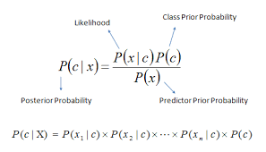
Machine Learning Techniques
SVM – A line that splits input variable space.
Naive Bayes – It uses probability to predict different classes based on various attributes.

Slide 13
Machine Learning Techniques
Logistic Regression - It is a statistical Model with one or more independent variable and categorical dependent variable.
K-Nearest Neighbors - An object is classified by a majority vote of its neighbors.
Decision Tree - It is a tree-like graph or model of decisions and their possible consequences.
Random Forest – It operates by constructing multiple decision trees.

Slide 14
Bag of Words(accuracies)-
Model | Kaggle | Combined
SVM | 97.98 | 96.21
Naive Bayes | 98.42 | 92.07
Logistic Regression | 97.48 | 95.46
K-Nearest Neighbors | 93.10 | 94.24
Decision Tree | 96.62 | 95.26
Random Forest | 97.98 | 96.50

Slide 15
Drawbacks of BoW
In this model all words are dumped in bag randomly.
In bag of words, it does not consider the order of words.
In this model, context of message is ignored.
For example :
Text 1 : Are you free? ( a ham SMS )
Text 2 : Free!! Only for you. ( a spam SMS )
This model may treat above two sentences in similar manner.

Slide 16
How to overcome?
By remembering context of message.
This can be done by using Recurrent Neural Networks.

Slide 17
RNN Model
Data Collection
Data Labelling
Data Preprocessing
word2vec
LSTM
SPAM
HAM

Slide 18
Word2Vec
Word2vec technique is used for obtaining numerical representation of words.
Word2vec can give near numerical representation of similar words.

Slide 19
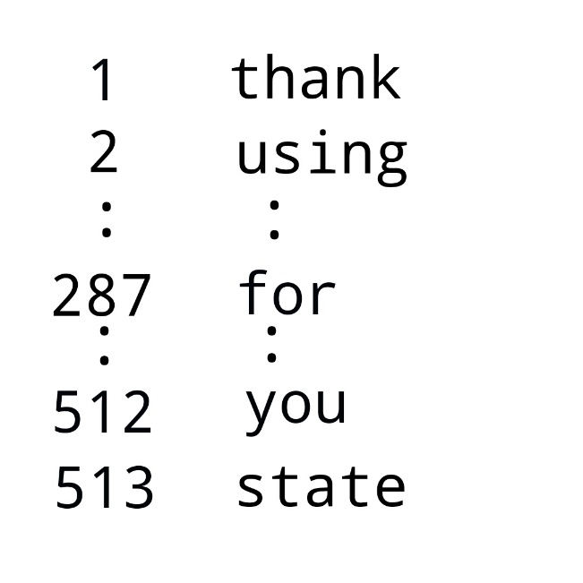
Building word2vec
We need to built a dictionary which contains all words of the dataset.
Sample SMS: thank you for using state bank internet banking.
Sample dictionary:

Slide 20
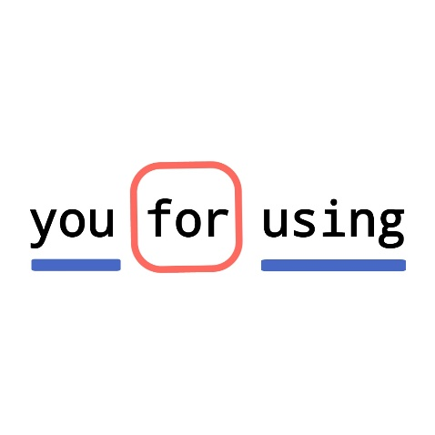
Building word2vec
Sample SMS: thank you for using state bank internet banking.
If we consider word ‘for’ , you and using are
target words.

Slide 21
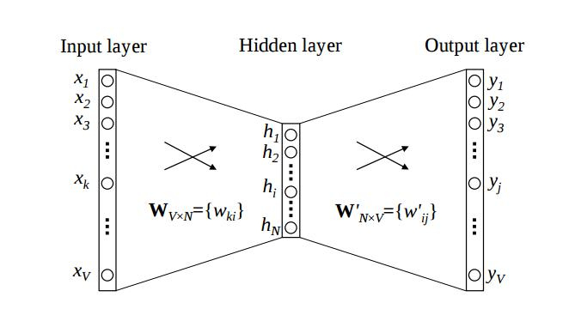
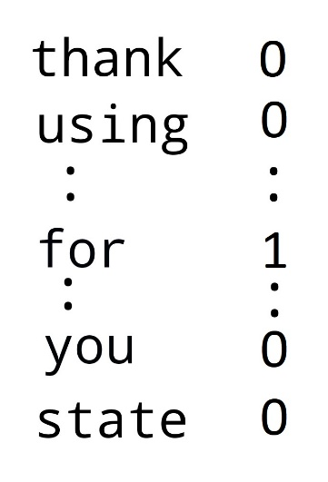
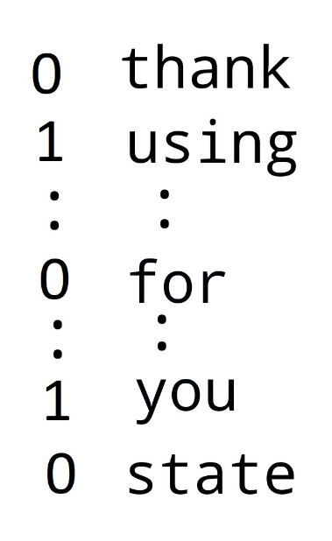
Building word2vec
Word2vec is simple 3-layer Neural Network.

Slide 22

Recurrent Neural Networks
A RNN has loops in them that allow information to be carried across neurons while reading in input.

Slide 23
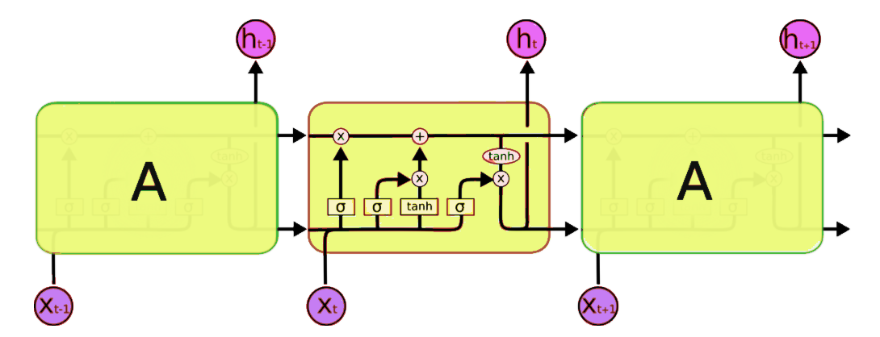
Long-Short Term Memory (LSTM)
LSTM Networks are special kind of RNN, capable of learning long- term dependencies.

Slide 24
Padding
To perform matrix operations efficiently, we need to make sure that each input data should be of equal length.
So, we did padding to make each message of 200 length.

Slide 25
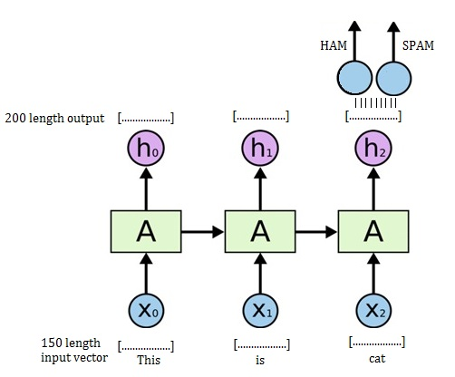

Slide 26
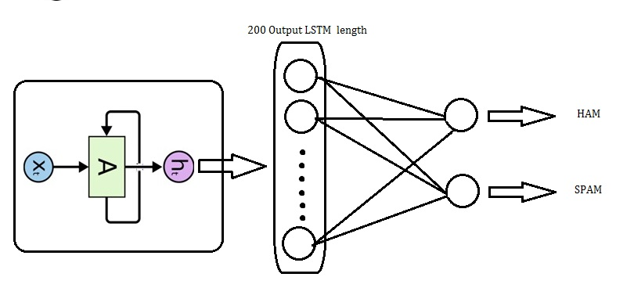
LSTM Network in our Model
We input each word of message into the network in a sequence
Output length of LSTM is 200 and it is connected 2 node output layer.
These 2 nodes at the end determine whether a SMS is spam or ham.

Slide 27
LSTM Result
English (Kaggle)
Accuracy | Error Rate | Spam Caught | Blocked HAM
97.91 | 2.09 | 87 | 0.27
Multilingual
Accuracy | Error Rate | Spam Caught | Blocked HAM
96.8 | 3.2 | 89.4 | 1.31

Slide 28
Model 2
Word2vec’s first two layers is directly connected to LSTM’s input.
Accuracies :
Kaggle ( English ) – 99.4%
Multi-lingual – 94.2%

Slide 29
Technology/Implementation
Tools | Spyder , Jupiter Notebook
Languages | Python
Python Libraries | Pandas, numpy, tpot, nltk, genism, sklearn ,keras, tensorflow
Sms Extraction | SMS_to_Excel android app

Slide 30
Challenges
Manually labelling of 10167 data.
For example-
Recharge your AIRTEL number with Rs.448 & enjoy UNLIMITED ALL Calls (including ROAMING) + 70GB (1GB/Day) + Free SMS for 70 Days! For ALL Phones (4G/3G/2G)
For someone it might be spam or may be ham.
It took 10GB ram while training the model.
We don’t have a graphic card to train the model. So, it took lots of time to train.
We implemented Lang2vec which is a future scope work, but while training it took beyond our available resources (12GB ram).

Slide 31
Conclusion and Future scope
Efficient multi-lingual SMS spam detection has been achieved using Recurrent Neural Networks.
We need to implement stacking on LSTM.
Lang2vec can be used instead of word2vec may give better results.

Slide 32
Contributions
Standard multi-lingual dataset is made publicly available which contains around 10000 records.
We made this project publicly available on GitHub.
Link - GitHub link.
We are writing a research paper based on this work.

Slide 33
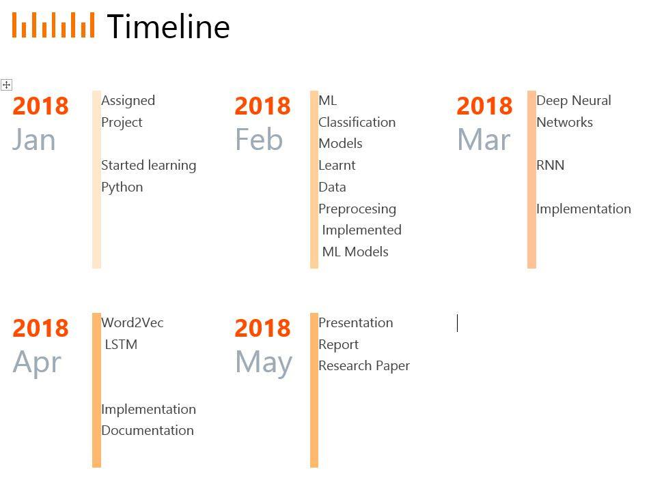

Slide 34
Individual contributions
Pooja Barathi – Data labelling, Machine Learning Techniques
Shashank – Bag of words, Machine Learning Techniques, word2vec
Manohar – Word2vec, LSTM

Slide 35
Thank You

